Slide 1
Spotify Data Visualization
Muni Lohith Krishna Mohan Konidala
Maanusri Balasubramanian
Sanjana Radhakrishna

Slide 2
Why Spotify?

Slide 3
Data
Dataset: Spotify Charts | Kaggle
This dataset is an entire public collection of all the “Top 200” charts and “Viral 50” charts published globally by spotify every 2-3 days since January 1, 2017
Huge dataset with 22 million rows !
Goals:
Reduce the size of dataset by filtering the core data that we need
Define proper set of users for your visualizations
Get best possible visualizations using the filtered dataset as a whole
Make the visualizations user friendly for all types of users

Slide 4
Decisions to compress this huge dataset:
Find Top 100 artists from the entire world. Draw all your visualizations on the data belonging only to those top 100 artists.
Not to handle trends and daily rankings.
Excluded “Viral 50” charts and analysed only “Top 200” charts.
We grouped all the “Top 200” charts in a single year for each artist, region, song, url into a single row
Added country code to all the rows of our processed dataset
The final dataset is of size 116667 rows !

Slide 5
Users
User1(Artist):
Artist is a persona who creates new music and uses the data visualization produced by the dataset to analyze and sometimes take feedback on their actions.
User2(Producer):
Producer is one such persona who produces/sponsors music albums.
User3(Spotify User):
Spotify user is one who likes to listen to songs on spotify and makes use of the data visualization produced by using spotify dataset to answer their questions.

Slide 6
Tasks
User 1 (Artist):
Task 1: Artists want to identify how their songs streamed over the years on
Spotify
Task 2: Artist wants to comprehend their top 10 songs globally streamed on
Spotify
Task 3: Artist wants to compare himself with other artists
Task 4: Artist wants to identify the more profitable/impactful regions for their next
coming tour/live concert

Slide 7
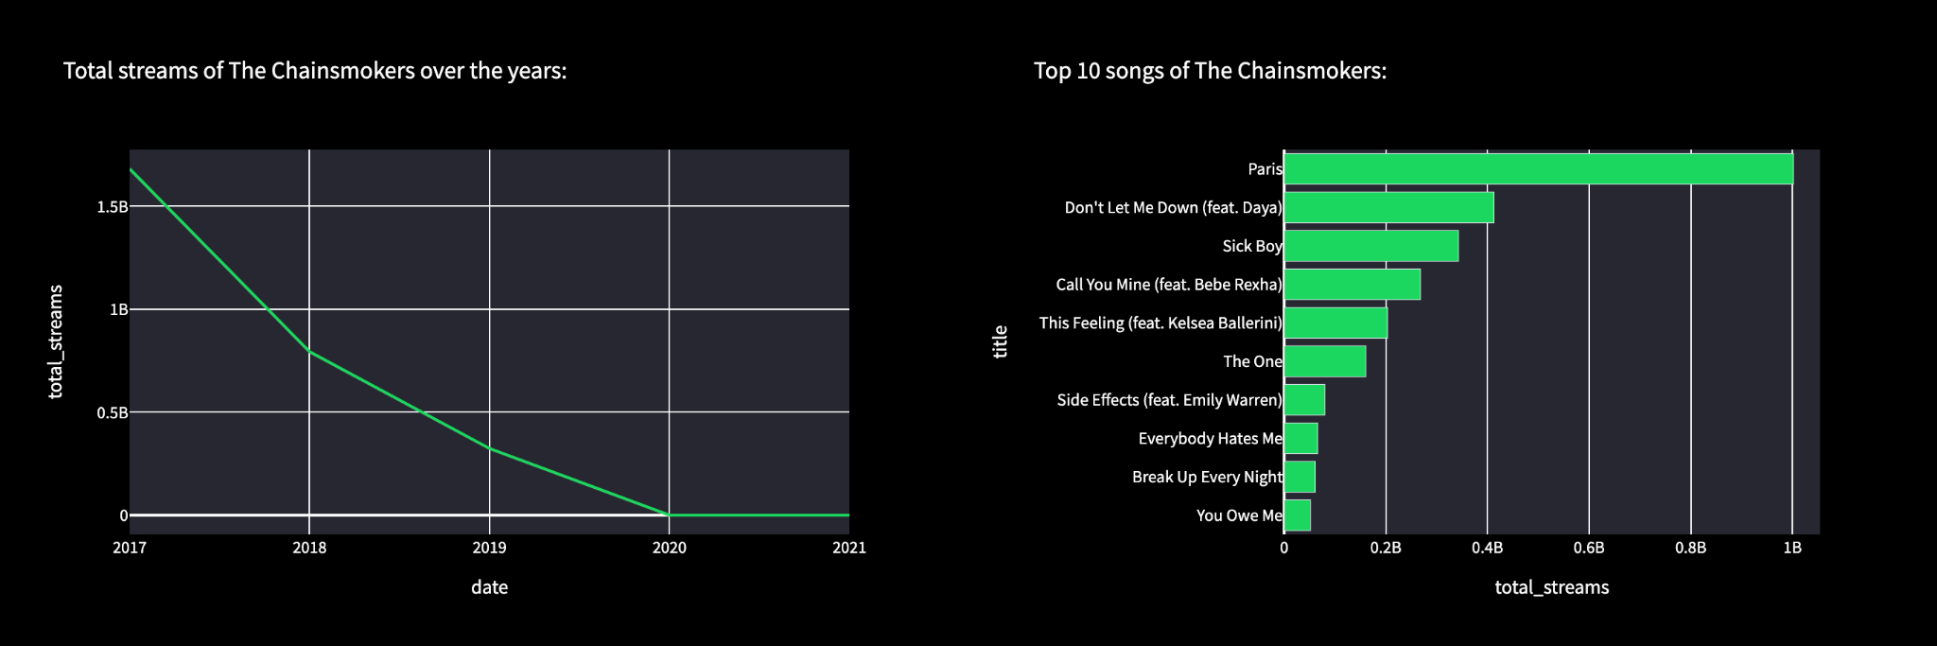
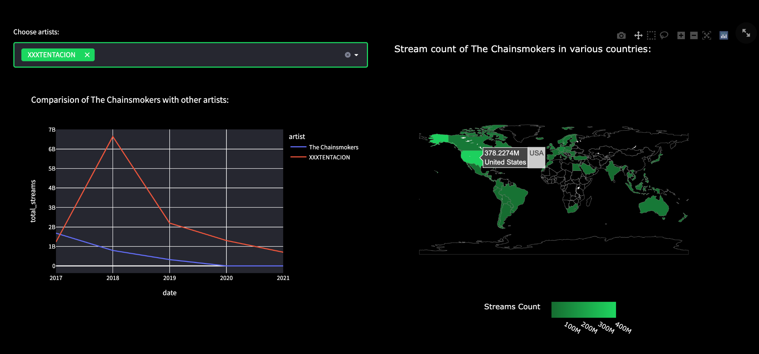

Slide 8
Tasks
User 2 (Producer):
Task 1: Producer wants to compare the number of streams of various artists, to
decide on the artist for the next album they plan to produce.
Task 2: Producer wants to identify the region with the most streamers on Spotify.
Task 3: Producer wants to analyze and rank the artists according to the number of streams on spotify.
Task 4: Producer wants to know the top artist in each country, so that he can have a contract with the most popular artist for songs targeted on a particular region.

Slide 9
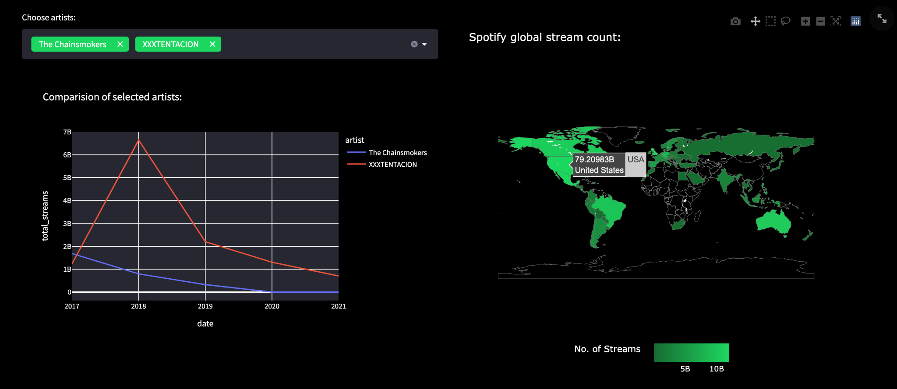
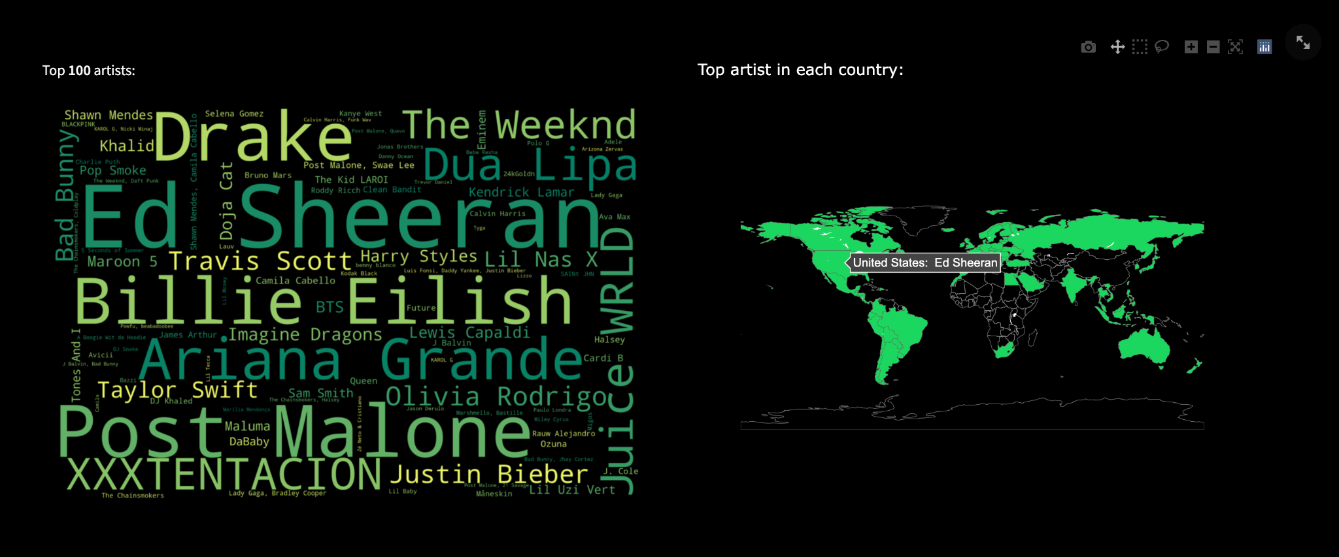

Slide 10
Tasks
User 3 (Spotify User):
Task 1: Spotify User wants to know top 10 songs of a certain artist of his choice
Task 2: Spotify User wants to know the most popular artist in their country on
Spotify
Task 3: Spotify User wants to know top artists in the world
Task 4: Spotify user wants to know top 10 songs of all time

Slide 11
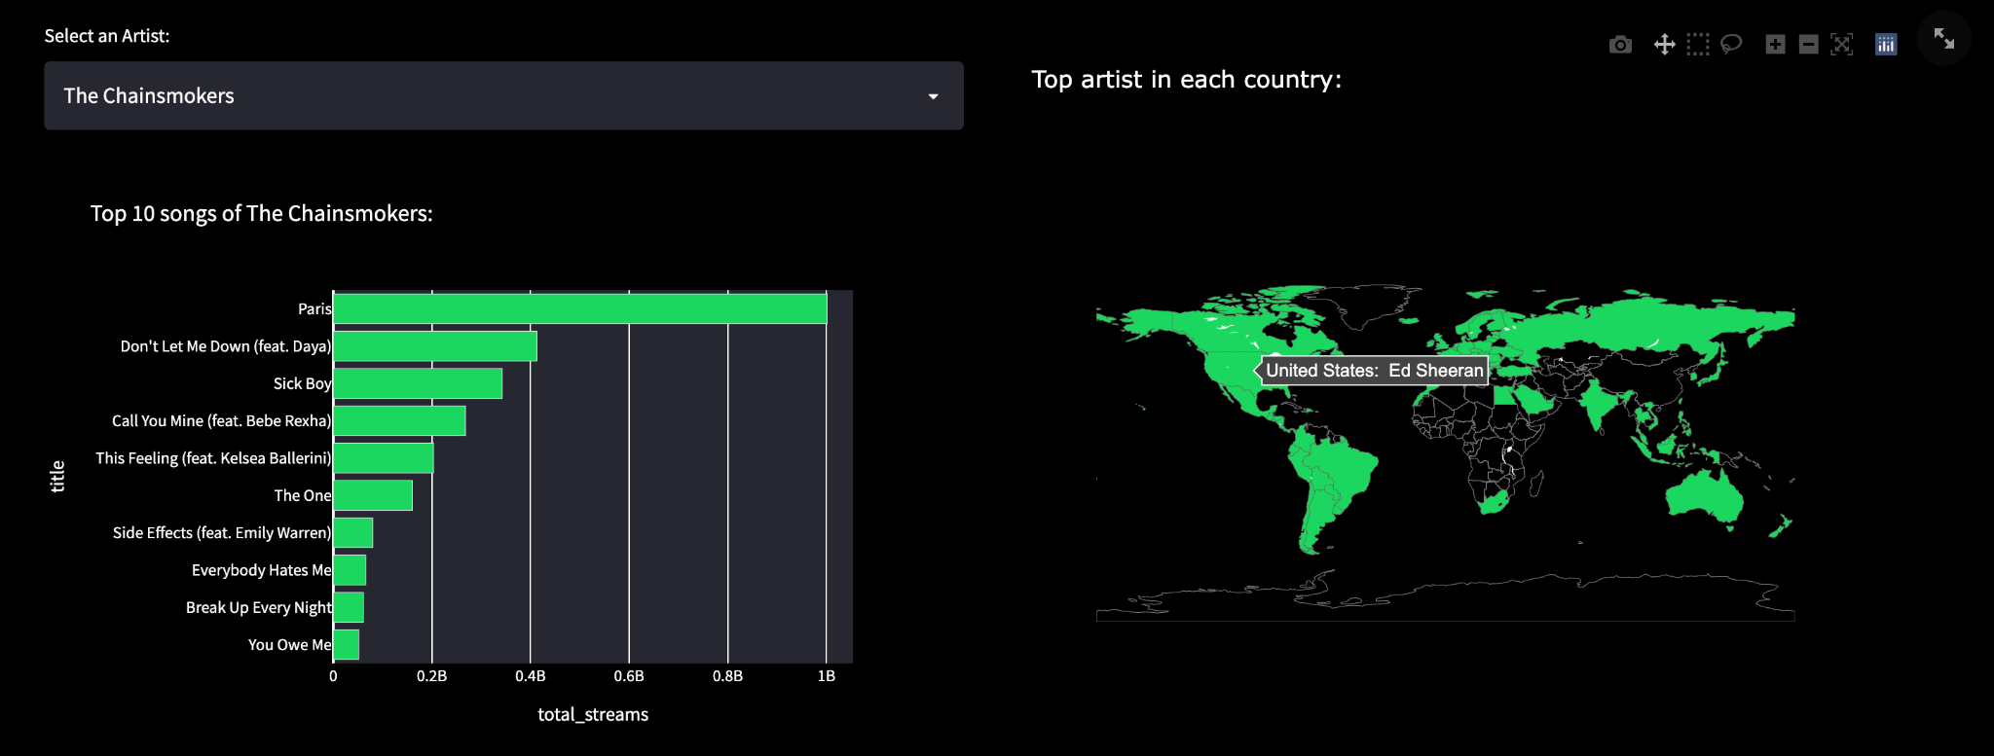
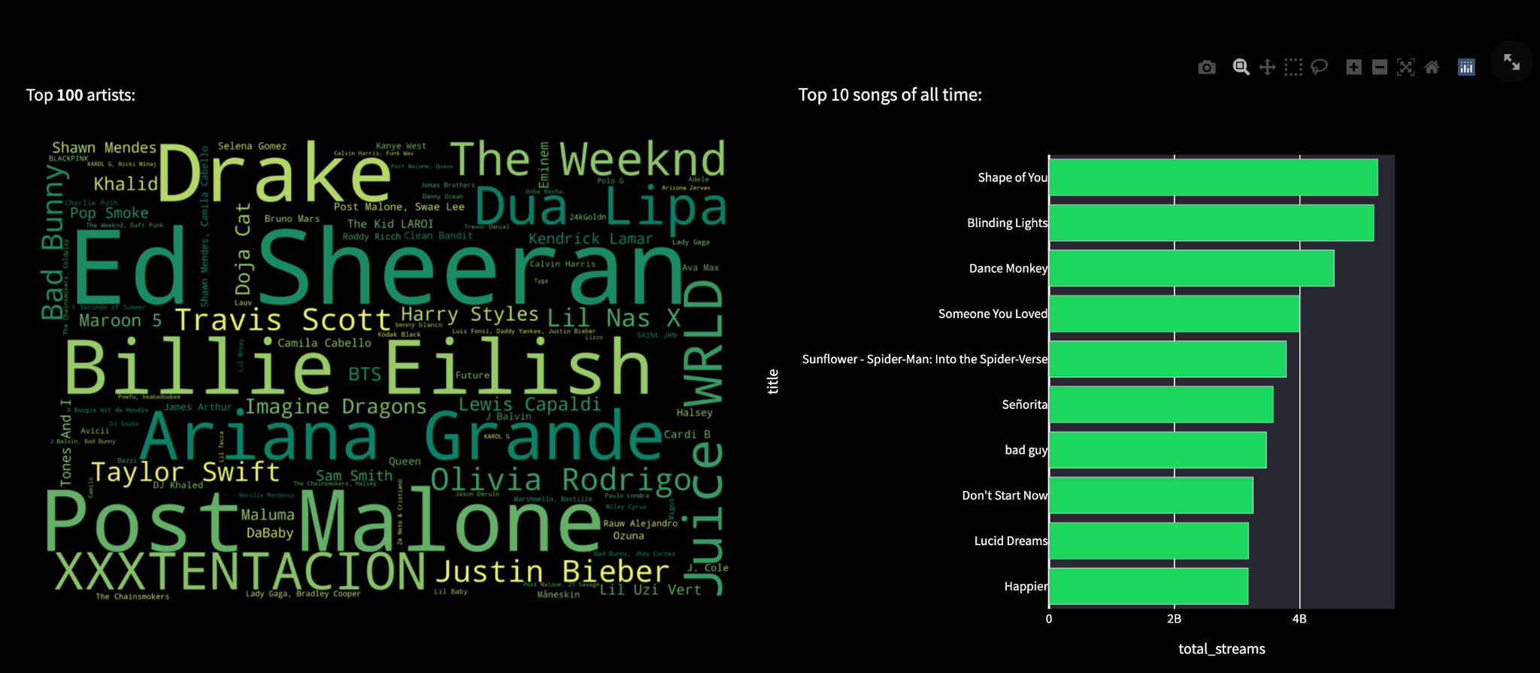

Slide 12
Time for a Demo!

Slide 13
Challenges Faced
Data preprocessing
Getting the entire dashboard into a single frame - Streamlit
Long time (5-10 sec) to build a word cloud. Hence we built and used a static word cloud.
Slight disruption in UI - Issue with Streamlit. Used proper containers and verified all the properties on UI components. Tried to reach out for solution on stack overflow and few blogs related to streamlit.
Designed custom UI colours that matches Spotify by configuring .streamlit/config.toml file

Slide 14
User Evaluation:
While comparing artists, we used stream count as a metric but user enquired if they was any better metric to do this - Insufficient data
User suggested to use color transitions in world map - research shows color saturation is the best channel
User suggested best artist name to be displayed over each country - slightly clumsy
User asked how would they know that they need to hover on the world map to visualize the actual data - info button for each graph

Slide 15
Thank You!

